Slide 1

Beacon Psychosocial Safety Solution
The Beacon Index enables businesses to mitigate risk, improve wellbeing and measure workplace experience in real-time.
Because everyone deserves a safe and supportive workplace..
Workplaces that embed Beacon into business-as-usual safety best-practice are set up for greater psychosocial success.

Slide 2
Beacon brings data and insights that help your business:
Manage & Comply
Better manage and comply with SafeWork and ISO 45003 psychosocial safety requirements.
Implement & Report
Implement and report on psychosocial consultation, early issue detection, and continuous improvement
Proactively Manage
Proactively manage psychosocial risk including stress, workload and conflict

Slide 3
How does it do this?
Visibility of Risk Indicators
Simple Feedback Channel
Visibility of employee and team psychosocial risk indicators to enable early response and reduce incidents
A simple and consistent way for employees to provide feedback, flag their feelings, and seek support
Beyond Traditional Metrics
Trusted Communication
Measurement that goes beyond traditional safety measure such as LTIFR and indicates emotional sentiment and safety.
A trusted, regular, and easy to use channel for feedback
Workplaces that embed Beacon into business-as-usual safety best-practice are set up for greater psychosocial success.

Slide 4
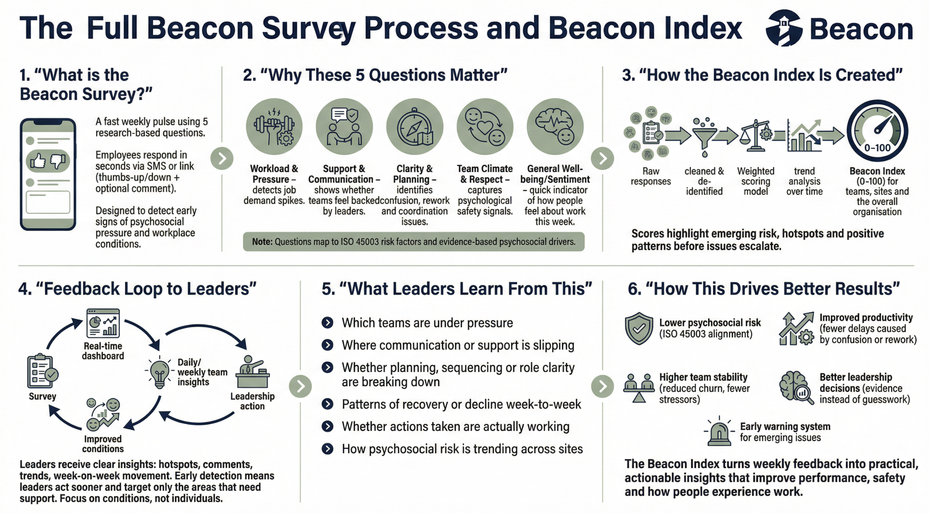
What is the Beacon Survey?
A fast weekly pulse using research-based questions.
Employees respond in seconds via SMS or link with 3 options available for each.
The questions are designed to detect early stages of psychosocial pressure and workplace conditions.

Slide 5





Why these 5 Questions Matter
Workload & Pressure
Detects job demand spikes
Support & Communication
Shows whether teams feel backed by leaders
Clarity & Planning
Identifies confusion, re-work and coordination issues
Team Climate & Respect
Captures Psychological safety signals
General Wellbeing / Sentiment
Quick indicator of how people feel about work this week
Note: questions map to ISO 45003 risk factors and evidence based psychosocial drivers

Slide 6
How the Beacon Index is Created
Raw Responses
Cleaned & de-identified
Weighted Scoring model applied
Dashboard generated with trend analysis over time
Beacon Index (0-100%) for teams and the overall organisation

Slide 7
Feedback Loop to Leaders
Leaders receive clear insights: hotspots, comments, trends, week-on-week movement and patterns. Early detection means leaders act sooner and target only the areas that need support.
Focus on conditions, not individuals

Slide 8
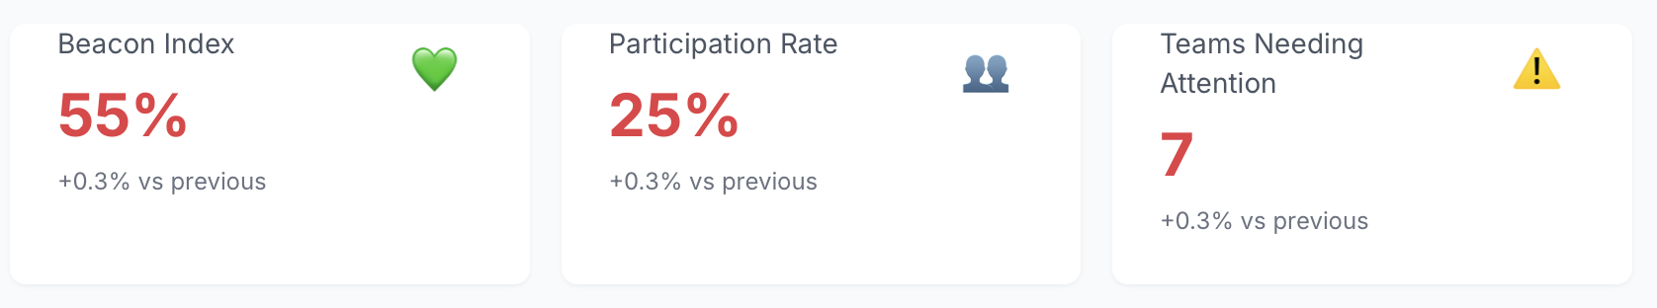
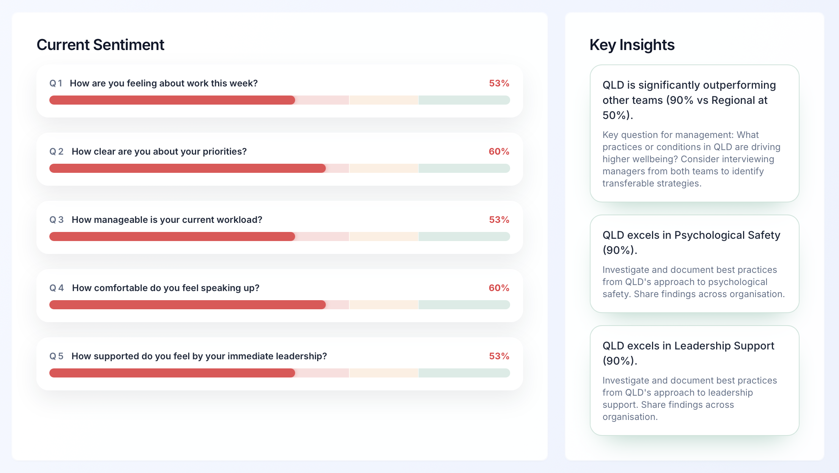
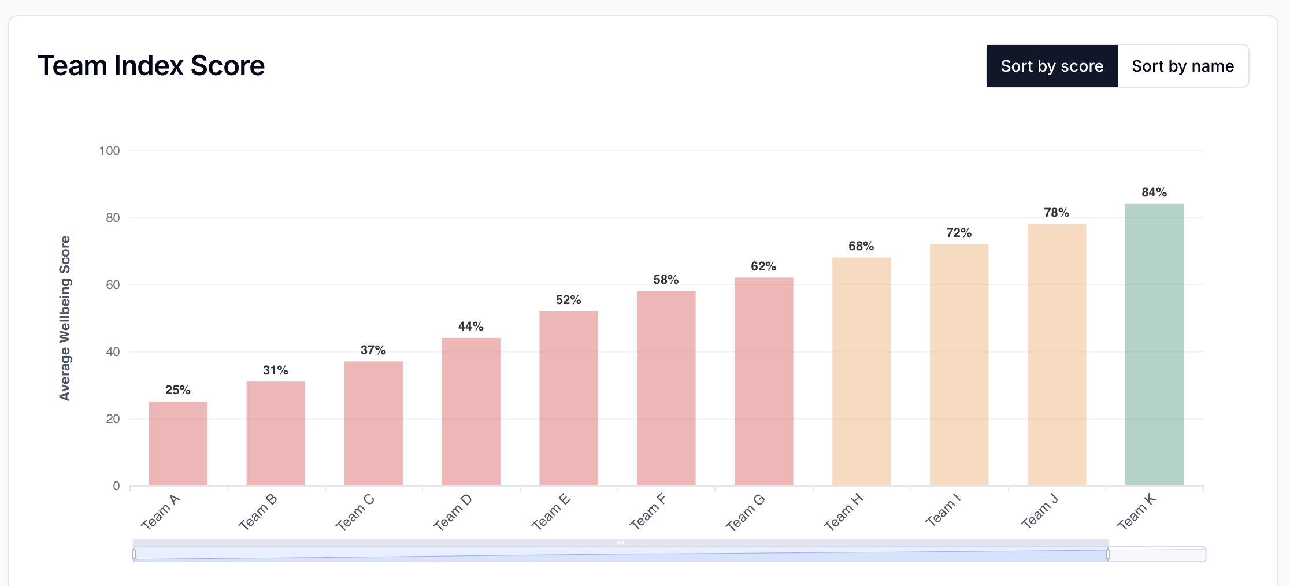
What Leaders Learn From This
Which teams are under pressure
Where communication or support is slipping
Whether planning, sequencing or role clarity are breaking down
Patterns of recovery or decline week-to-week
Whether actions and initiatives are working
How psychosocial risk is trending across sites.

Slide 9
How This Drives Better Results
Lower Psychosocial risk
ISO 45003 alignment
Improved Productivity
Fewer delays caused by confusion or rework
Higher Team Stability
Reduced churn, fewer stressors
Better Leadership Decisions
Evidence instead of guesswork
Early Warning System
For emerging issues
The Beacon Index turns weekly feedback into practical, actionable insights that improve performance, safety and how people experience work.

Slide 10
Benefits of Embedding Beacon
Early Conversations
Immediate Support
Encourages early and open conversations about issues that impact psychosocial safety
Immediate and discreet support for employees flagging psychosocial issues
Data from 7,500 companies shows that businesses with happier employees outperform the market.
“Whether you are an employee or employer, it is a better investment to increase happiness at work and in life, rather than simply trying to increase measures of success
In the end, happiness leads to success—not the other way around”.
Arthur C. Brooks,
Harvard School of Business

Slide 11
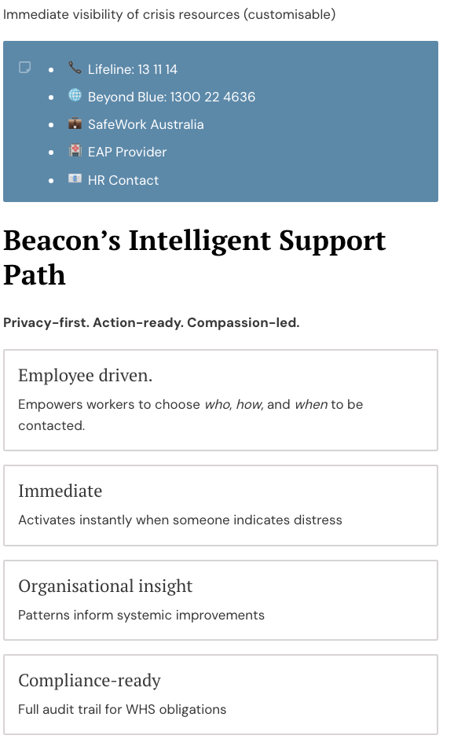
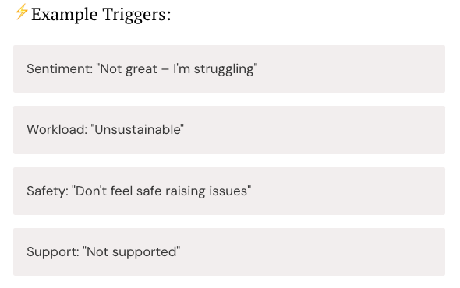
Immediate Support & Insight
When someone flags as "struggling" or at risk support is offered immediately and respectfully.
This process directly supports your WHS duty to consult, support, and respond to psychosocial risks.

Slide 12
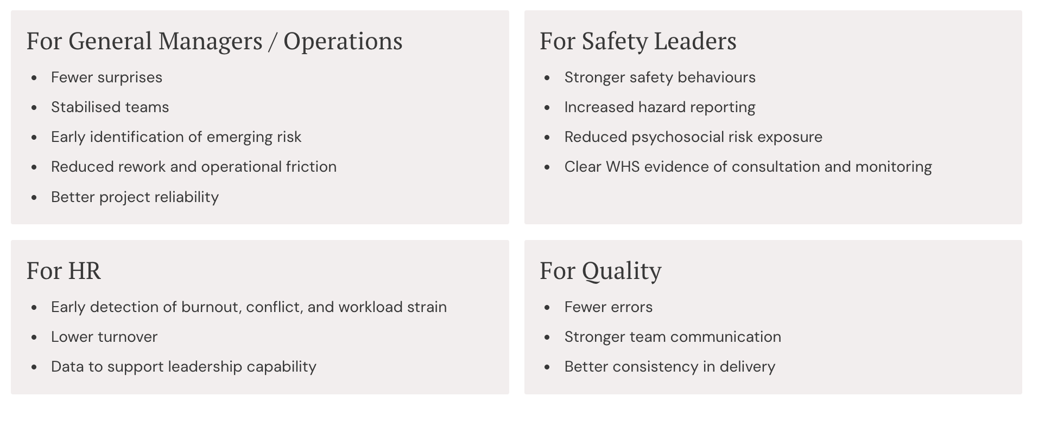
A Single Tool Solving Multiple Executive Problems

Slide 13
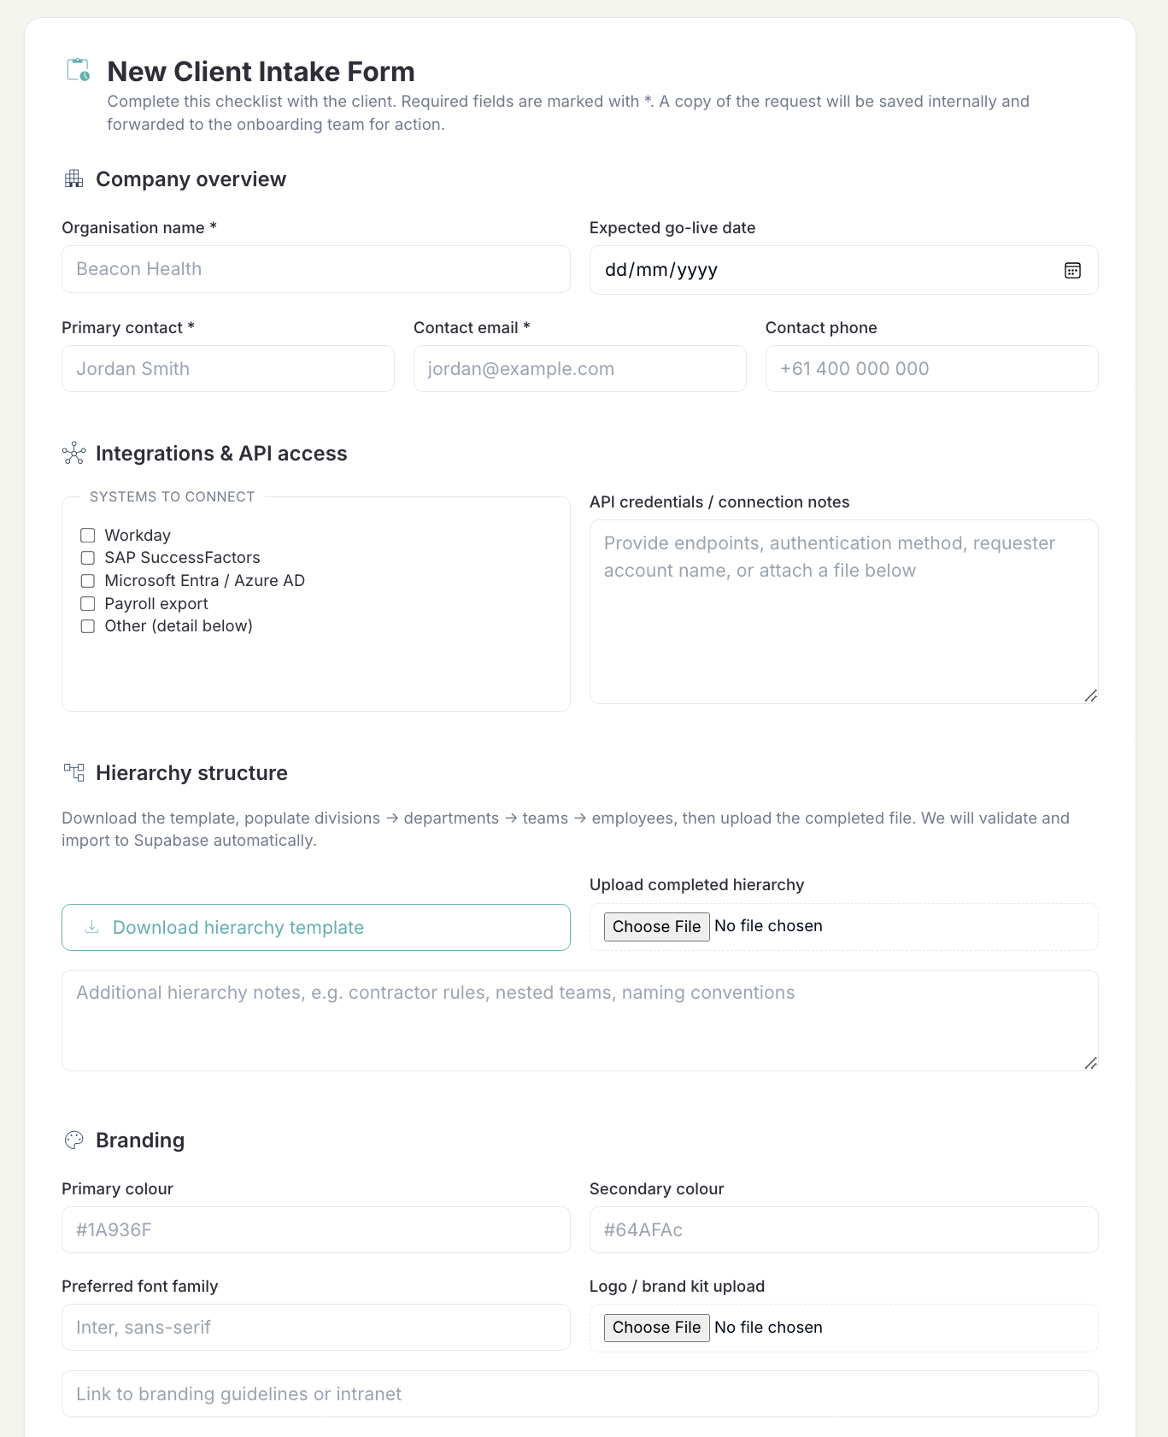
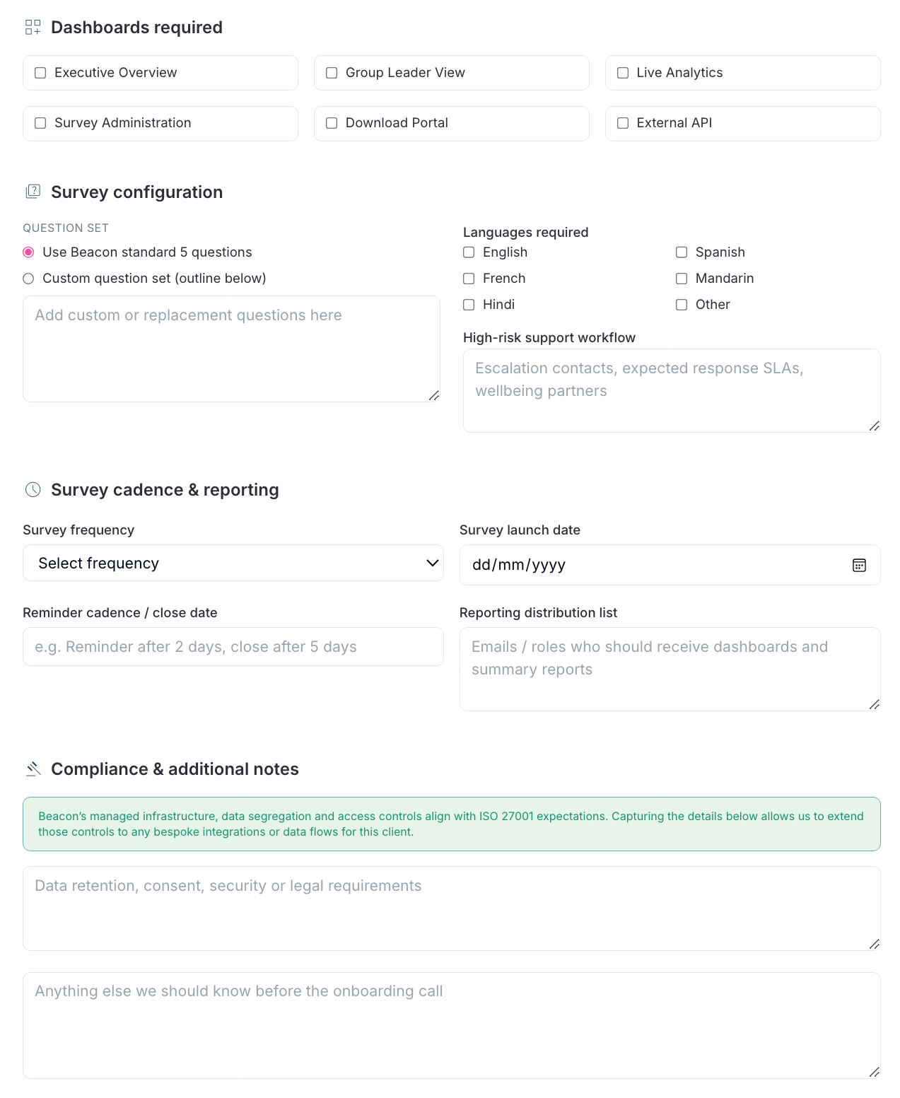
Onboarding Details
Beacon’s Onboarding process ensures we capture hierarchy details, branding, dashboard requirements and delivery cadence so we can configure your environment, integrations and reporting workflow ahead of launch.
(A link will be issued via email upon confirmation of POC proceeding).

Slide 14
Next Steps
Week 1 - 2
Week 3
Week 4
Setup & Configuration
First Pulse + Dashboard Training
Review & Optimise
Define system requirements (API connections).
Establish user roles and reporting hierarchy.
Identify specific measures and dashboards.
Create communications plan and change management approach.
Load test data within agreed hierarchy.
Verify SMS/email delivery.
Train authorised leaders on dashboard usage.
Issue communications plan to staff and leaders
Launch first Index pulse.
Review data and adjust parameters if required.
Consider recognition or incentive programs depending on engagement.
Incorporate feedback into future pulse cycles.
Beacon Advisory provides ongoing analytics and leadership support to ensure your program remains tailored and effective

Slide 15
Beacon Index POC Fee Proposal
ISO-aligned secure platform hosting
Anonymous worker check-in delivery
Real-time Beacon Index score
Trend analysis across key indicators
Aggregated, de-identified reporting
Minimum thresholds to protect anonymity
Access to templates, support materials and comms packs
Dedicated onboarding
Monthly insights meeting (2 hours)
Simple Billing Model
No per-message fees
No usage-based charges
One predictable cost
Annual fees will apply beyond the POC term which are dependant on size of organisation and complexity of solution required.
$7k Establishment Fee
$5k flat fee for 3-month POC which includes:

